Slide 1

Academic Writing Course

Slide 2
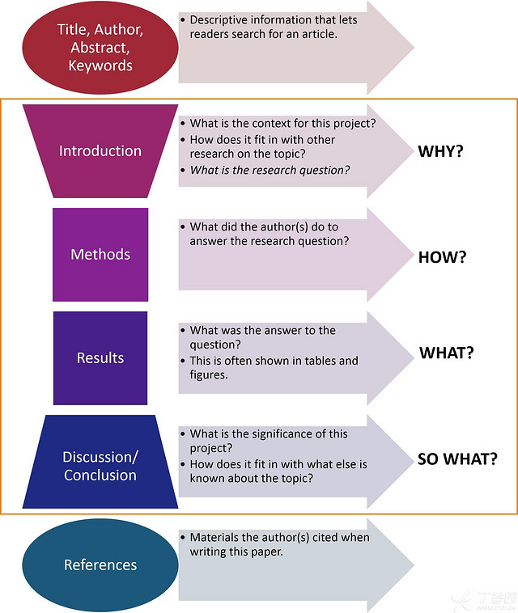
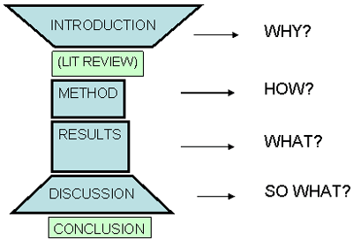
fact-driven
presents research findings
analyzes research findings
opinion-driven

Slide 3
Contents
1
Activities in Discussion
2
Elements in Discussion Section
3
Certainty about Claims
4
Cause and Effect

Slide 4


Meanings and Functions of Discussion
a) considering both sides of an issue, or a question before reaching a conclusion;
meanings
b) considering the results of research and the implications of these results.
a) to interpret the results in light of what has already known about the subject of the research;
functions
b) to inspire a new understanding of the research question(s) after taking the results into consideration.

Slide 5

P72-73
Some expressions in Reading Passage
colorectal cancer 结直肠癌
lung cancer 肺癌
esophagus cancer 食道癌
liver cancer 肝癌
prostate cancer 前列腺癌
laryngeal cancer 喉癌
bladder cancer 膀胱癌
myeloma 骨髓瘤
colorectum 结肠直肠
malignancy 恶性肿瘤
rectal cancer 直肠癌
colon cancer 结肠癌
esophageal adenocarcinoma 食管腺癌
referent group 参照组
endometrial cancer 子宫内膜癌
attenuate 使减少；使减弱
body mass index 体重指数(BMI)
menopausal hormone therapy 绝经后激素治疗
null 不存在的
leukemia 白血病
melanoma (恶性)黑素瘤 ，(良性)胎记瘤
breast cancer 乳腺癌
estrogen 雌激素
progesterone 黄体酮
carcinogenesis 癌病变，致癌作用
saturated fat 饱和脂肪
free radical 自由基
oxidative stress 氧化应激
Notes:
氧化应激（Oxidative Stress，OS）是指体内氧化与抗氧化作用失衡，倾向于氧化，导致中性粒细胞炎性浸润，蛋白酶分泌增加，产生大量氧化中间产物。氧化应激是由自由基在体内产生的一种负面作用，并被认为是导致衰老和疾病的一个重要因素。

Slide 6

Introductory Paragraph
①In this large, prospective investigation of red and processed meat intake in relation to cancer risks, we found elevated risks of colorectal and lung cancer with both types of meat. ②Red but not processed meat intake was also associated with increased risk of cancer of the esophagus and liver. ③We statistically observed elevated risks of advanced prostate cancer with both red and processed meat intake, of laryngeal cancer with red meat intake, and of bladder cancer and myeloma with processed meat intake.
Purpose of the study
Key findings of the study
P72

Slide 7
we found elevated risks of colorectal and lung cancer with both types of meat.
Red but not processed meat intake was also associated with increased risk of cancer of the esophagus and liver.
We statistically observed elevated risks of advanced prostate cancer with both red and processed meat intake, of laryngeal cancer with red meat intake, and of bladder cancer and myeloma with processed meat intake.
Both types of meat | Red meat | Processed meat
Colorectal and lung cancer Advanced prostate cancer | Cancer of the esophagus and liver Laryngeal cancer | Bladder cancer and myeloma
①
②
⑤
③
④

Slide 8


P73
What has the passage discussed?
Para. | Contents
2
3
4
5
6
7
We observed a stronger positive association for rectal than colon cancer.
①
We found a positive association between red meat intake and cancer of the esophagus and the liver, and a significantly positive association for laryngeal cancer.
④
②
Unexpectedly we found an inverse association between red meat intake and endometrial cancer; …We also observed inverse associations between processed meat intake and leukemia and melanoma.
We observed a suggestion of an elevated risk of advanced prostate cancer with both types of meat.
③
With regard to breast cancer, a pooled analysis of eight cohort studies found no association with red meat intake;
Both red meat and processed meat can be linked to carcinogenesis by different mechanisms;

Slide 9
Paragraph 8
This study was primarily limited by its relatively small sample size. An earlier start in data collection would have increased the time needed to survey more participants. Ideally, the number of participants would have been more evenly distributed across gender/year in population. A larger sample with diversity would have benefited our results.
limitations of this study
Other limitations of this study included some possible measurement errors, although we attempted to minimize the errors in measurement and the measurement data compared very favorably to other research.
P74

Slide 10

Concluding Paragraph?
A diet high in red or processed meat was associated with an elevated risk of both colorectal and lung cancer;
Red meat was associated with an elevated risk of esophageal and liver cancer.
A decrease in the consumption of red and processed meat can reduce the incidence of cancer at multiple sites.
①
②
P74

Slide 11

Elements in Discussion Section?
Paragraph | Function
1
2
3
4
5
6
7
8
9
Provide a brief summary of key findings
Discuss possible mechanisms and explanations for the findings.
Compare study results with relevant findings from previous studies.
consider alternative explanations for the findings
Discuss the limitations of the present study
Conclude with a brief summary of key findings

Slide 12
Elements in Discussion Section
reference to the main purpose of the study
↓
a generalised review of the most important findings - summary of results
↓
possible explanations for the findings in general
↓
comparison with expected results and other studies
↓
limitations of the overall study that restrict the extent to which the findings can be generalised
Para. 1
Paras. 2-3
Paras. 4-6
Para. 8

Slide 13
Strong or Cautious Claim?
Focus on making claims on the basis of the data collected and then adding support to those claims
When the claims can be ascertained or justified, you should strengthen them.
When the evidence is less certain, you should be cautious to limit or weaken the claims

Slide 14
Example
Basic claim:
An increase in smoking among teenagers caused long-term health problems.
Basic claims | Stronger claims | Weaker claims
an increase
caused
long-term health problems
a sharp increase
a probable increase
undoubtedly caused
must have caused
contributed to
may have caused
widespread long-term health problems
It is clear that …
We must conclude that …
We have reason to believe that … /It is possible that …

Slide 15
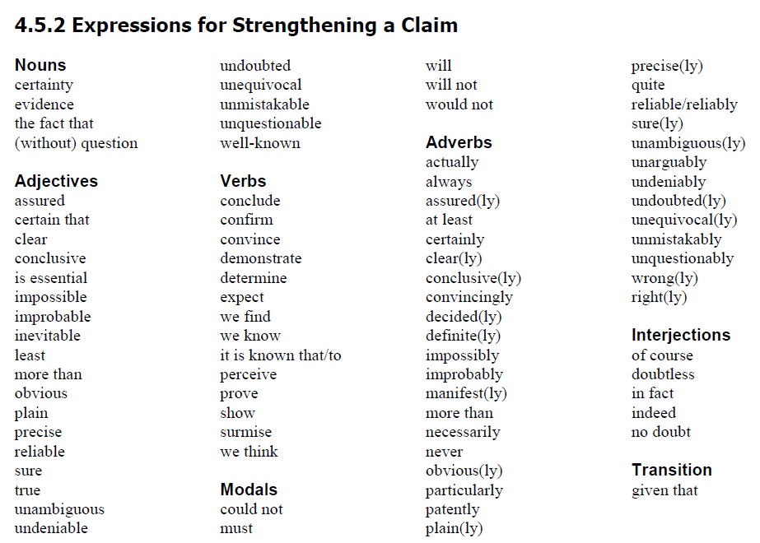

Slide 16
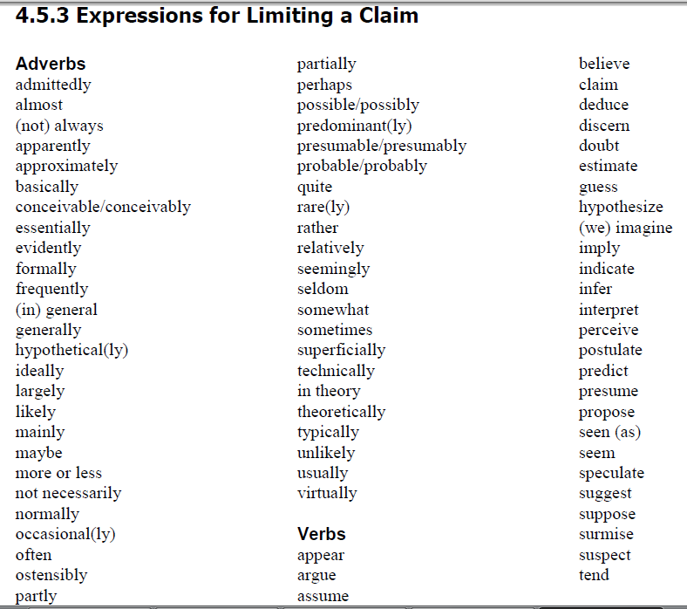
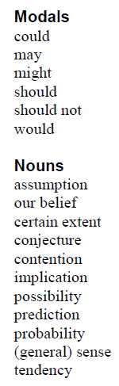
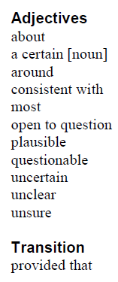

Slide 17
Read, compare, and decide
Read and decide which of the sentences below are considered to be academically competent.
1. The 'management' of danger is also not the sort of language to appear within policy documents that refer to GRT children, where it might be construed to reflect systematic failures in schools.
2. The 'management' of danger is also not the sort of language to appear within policy documents that refer to GRT children, which reflects systematic failures in schools.
Notes:
The 2nd sentence does not use hedging language. It makes a strong claim and makes no attempt to use cautious language. It is a very direct and very certain claim. This could be seen as impolite and also academically naive. http://aeo.sllf.qmul.ac.uk/Files/Hedging/Hedging.html

Slide 18
P80
Strengthening or Weakening a Claim?
1. Consistent with previous studies, we observed a stronger positive association for rectal than colon cancer.
2. It is possible that the referent group had a smaller-than-expected cancer incidence by chance.
3. We observed a suggestion of an elevated risk for advanced prostate cancer with both meat types.
4. In contrast to our findings, childhood leukemia has been positively associated with intake of processed meats in a case-control study.
5. Associations between saturated fat and cancer are likely to be related to energy balance in general, whereas iron is thought to contribute to carcinogenesis specifically by generating free radicals and inducing oxidative stress.
6. This could explain some of the inconsistencies in the literature as most previous studies have not specifically addressed advanced prostate cancer.
strengthening
weakening
weakening
strengthening
weakening
weakening

Slide 19
7. It lends strong support to implicate red and processed meat as risk factors for this malignancy.
8. We found a positive association between red meat intake specifically and cancers of the esophagus and liver.
9. A decrease in the consumption of red and processed meat could reduce the incidence of cancer at multiple sites.
10. An earlier start in data collection would have increased the time needed to survey more participants. Ideally, the number of participants would have been more evenly distributed across gender/year in population. A larger sample with diversity would have benefited our results……….
11. Our study suggests a threshold effect for red meat intake on esophageal cancer risk,…
12. Although breast cancer risk related to meat intake did not appear to differ by menopausal status in our study, we had very few premenopausal cases (n = 94) and lacked information on hormone receptor status for a large number of cases.
strengthening
strengthening
weakening
weakening
weakening
weakening

Slide 20
P75
Language Focus—Cause and Effect
Read the following sentences taken from the passage and find out their internal causal relations
1. Our study included 1,000 colorectal cancer cases, and it lent strong support to implicate that the intake of red and processed meat could be possible risk factors for this malignancy.
2. Associations between saturated fat and cancer are likely to be related to energy balance in general, whereas iron is thought to contribute to carcinogenesis specifically by generating free radicals and inducing oxidative stress.
Sentence | Cause | Effect
1
2
the intake of red and processed meat
this malignancy
iron
carcinogenesis

Slide 21
effects
therefore consequently so
as a result in consequence
accordingly thus hence
because of this
for this reason
result in lead to cause
bring about give rise to
produce contribute to
causes
due to because of
owing to
as a result of
on account of for
on the ground of
through because
since as
on the ground that

Slide 22
P77-78
Exercise
Complete the following paragraph by filling in missing causal words.
Recurring headaches can have disruptive effects on a person's life. Firstly, in many cases, these headaches make a person nauseous to the point that he or she must go to bed. Furthermore, sleep is often interrupted (1)__________ the pain. Disrupted sleep worsens the physical and emotional state of the sufferer. For those who try to maintain a normal lifestyle, drugs are often relied on to get through the day. Such drugs, of course, can (2)__________ other negative effects. Drugs can inhibit productivity on a job, perhaps even (3)_________ regular absences. Not only is work affected, but the seemingly unpredictable occurrence of these headaches (4)_________ disruption in family life. The interruption to a person's family life is enormous: cancelling plans in the last minute and straining relationships with friends and family. It is no wonder that many of these people feel discouraged and even depressed (5)________ the cycle of misery reoccurring headaches cause.
because of
lead to
causing
causes
due to

Slide 23
P78
Turn the following notes into a paragraph of cause and effect
Lack of water dryness in the soil leaves wilt death of plant.
If there is little water, the soil becomes dry, causing the leaves to wilt.
Too much water leaves droop or become yellow death of plant.
If there is too much water, the leaves droop or become yellow.
Too strong sun baked soil roots killed death of plant.
If there is too strong sunshine, the soil will be baked, killing the roots.
Lack of light pale leaves & thin stems death of plant.
If there is little light, the leaves will become pale and the stems thin.

Slide 24
P78
Turn the following notes into a paragraph of cause and effect
Lack of water dryness in the soil leaves wilt death of plant.
Too much water leaves droop or become yellow death of plant.
Too strong sun baked soil roots killed death of plant.
Lack of light pale leaves & thin stems death of plant.
There are several factors to be taken into account when studying why some plants become weak or die. One reason is lack of water. Dryness in the soil causes the leaves to wilt, and may give rise to the death of the plant. On the other hand, too much water may result in the leaves drooping, or becoming yellow. While sunshine is necessary for plants, if it is too strong, the soil may be baked and the roots killed. However, if there is no light, the leaves will become pale and the stems thin. Consequently the plant may die.

Slide 25
Academic Writing Course
Thank You !

